Slide 1
Adversarial Robustness in Machine Learning Models

Slide 2
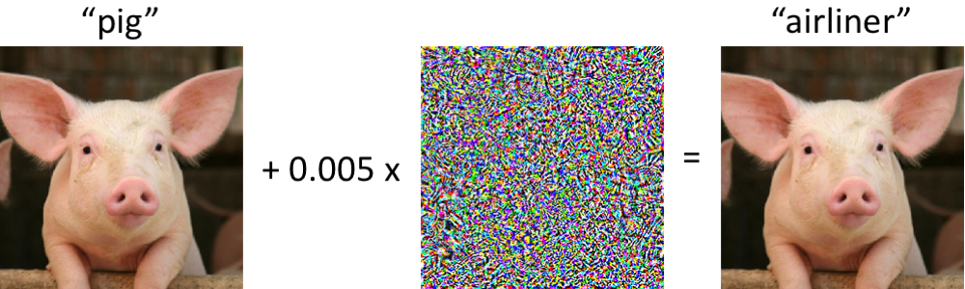
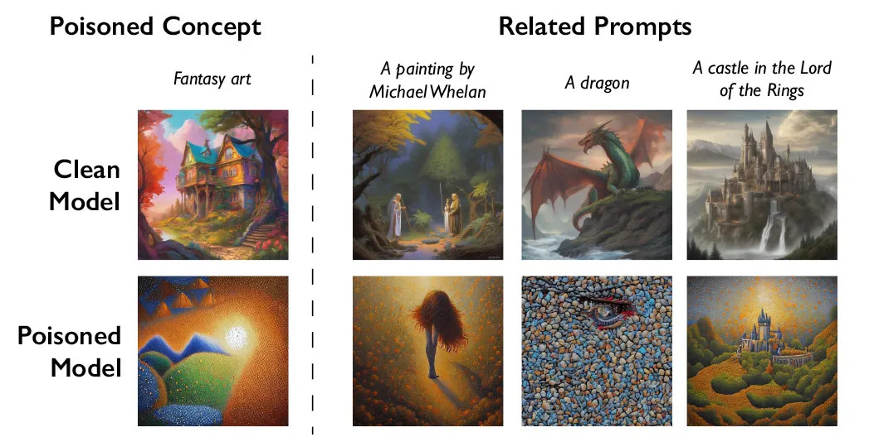
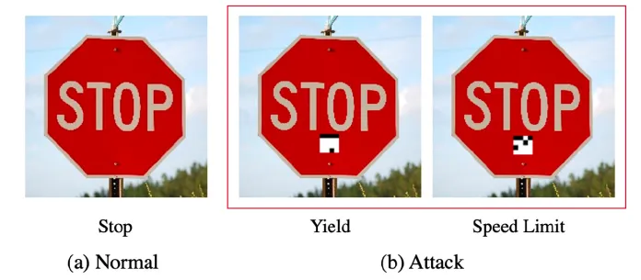
Adversarial Examples
Image Source: https://gradientscience.org
Image Source: https://resources.experfy.com/
Image Source: Ars Technica

Slide 3
Business Understanding
Applications
Image Recognition
Security
Privacy
Defense
Goals
Create adversarial data designed to trick the models
Document their effectiveness
Train robust models that can withstand adversarial attacks
Explain root cause behind misclassification

Slide 4
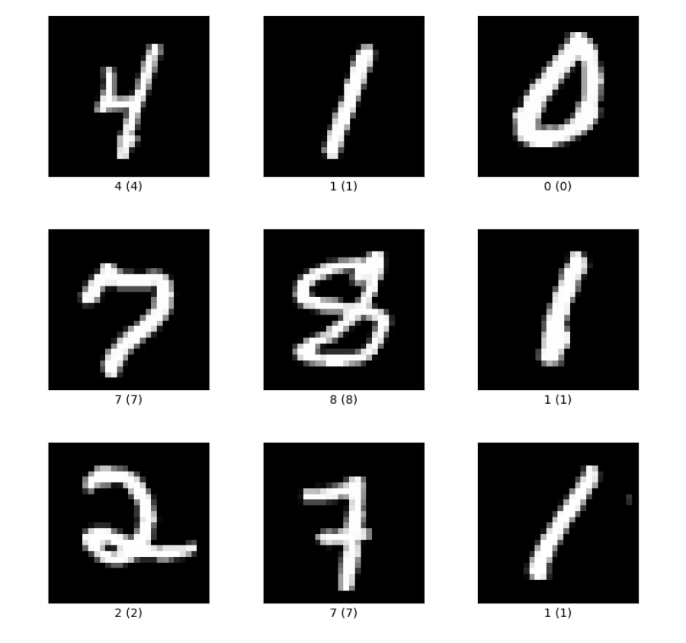
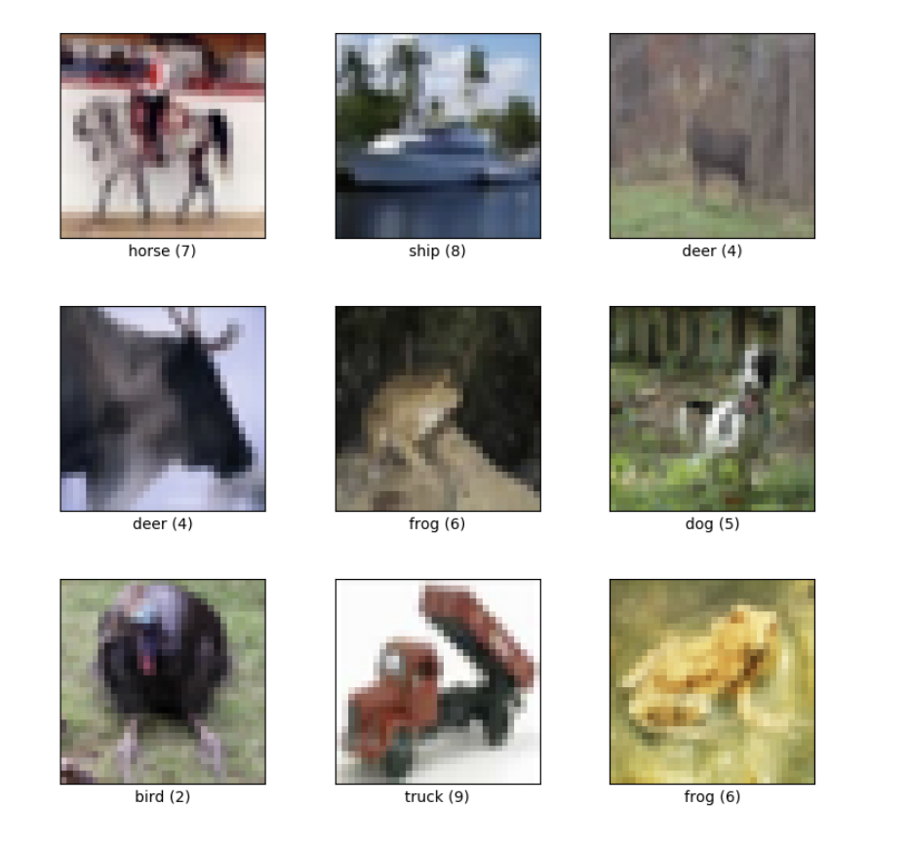
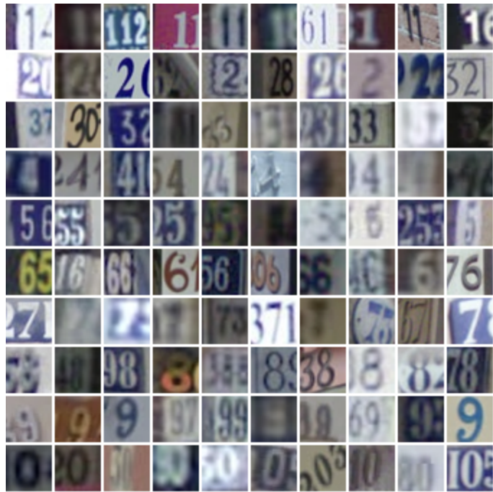
Data Understanding
MNIST
CIFAR10
SVHN
60,000 28x28 images
50,000 32x32 images
73,257 32x32 images

Slide 5
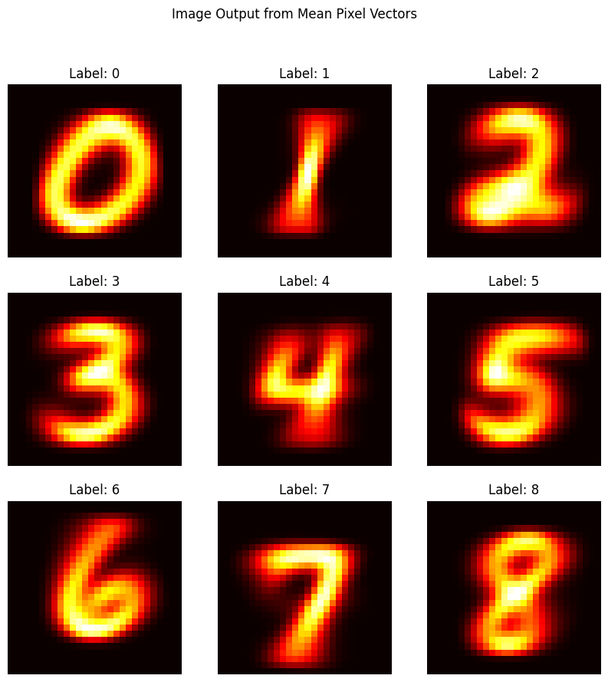
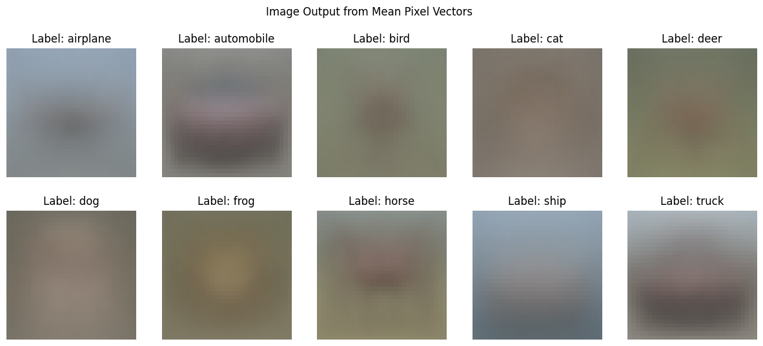
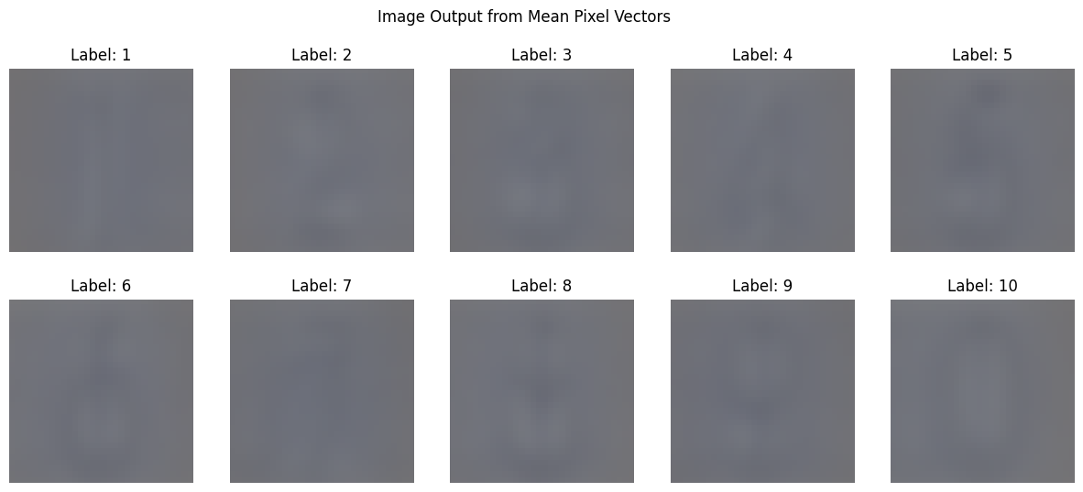
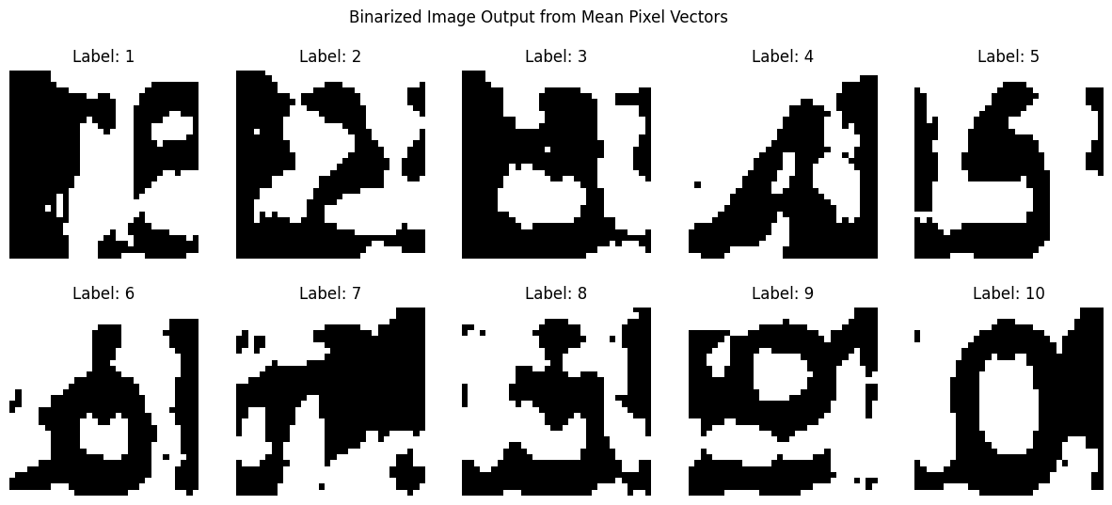
Data Understanding

Slide 6
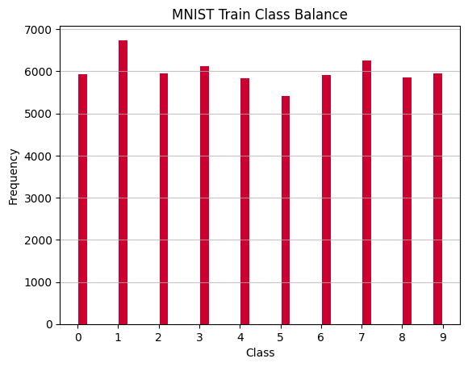
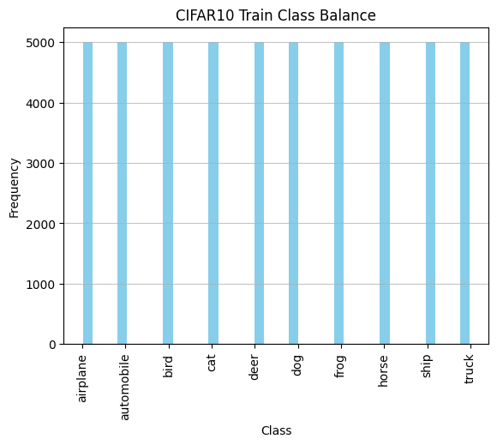
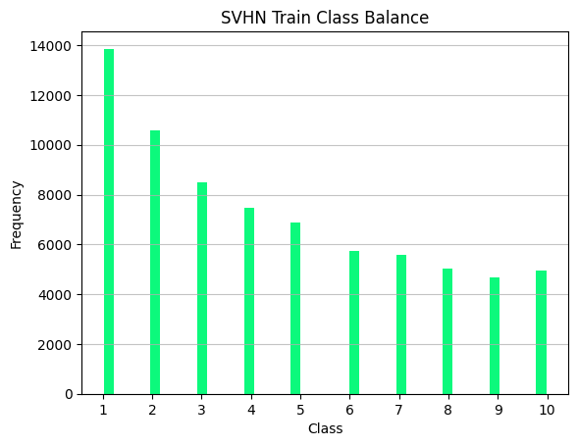
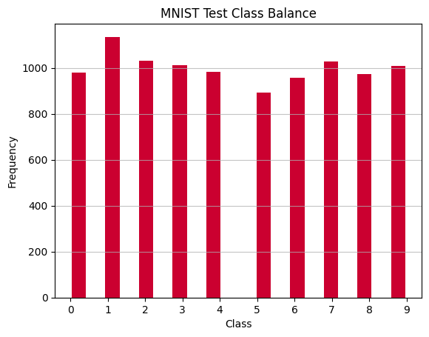
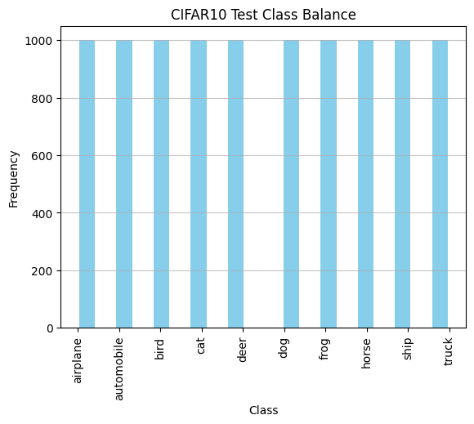
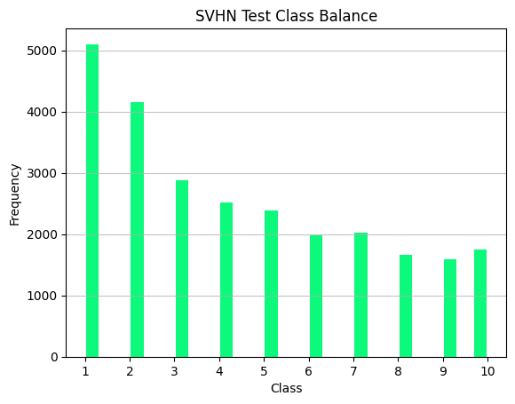
Data Understanding

